Slide 1
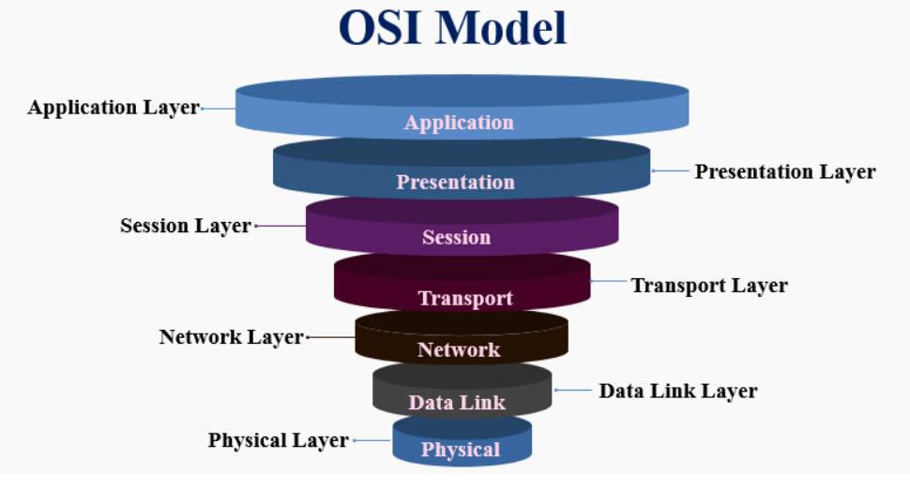
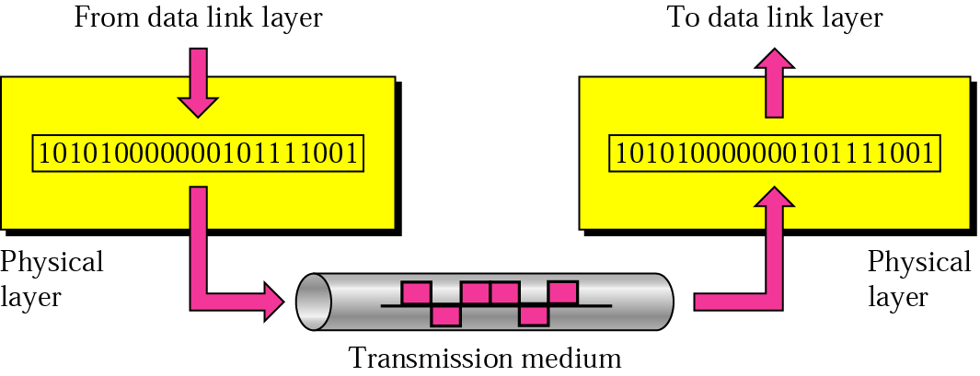
OSI Model (Open Systems Interconnection Model)
Layers in the OSI Model
In this section we describe the functions of each layer in the OSI model:
Physical Layer
The lowest layer of the OSI reference model is the physical layer.
It is responsible for the actual physical connection between the devices.
The physical layer contains information in the form of bits.
It is responsible for transmitting individual bits from one node to the next.
When receiving data, this layer will get the signal received and convert it into 0s and 1s and send them to the Data Link layer, which will put the frame back together.
The Physical layer is responsible for movements of individual bits from one hop(node) to the next

Slide 2
OSI Model (Open Systems Interconnection Model)
Physical Layer
The functions of the physical layer are:
Physical characteristics of interfaces and medium
Representation of bits
Synchronization of bits
Line configuration
Physical topology
Transmission mode
Hub, Repeater, Modem, Cables are Physical Layer devices.

Slide 3
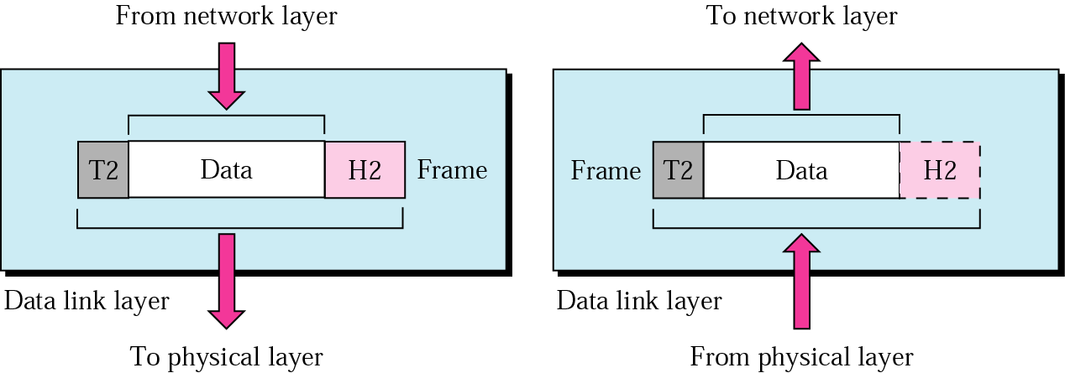
OSI Model (Open Systems Interconnection Model)
Data Link Layer
The data link layer is responsible for the node to node delivery of the message.
The main function of this layer is to make sure data transfer is error-free from one node to another, over the physical layer.
The data link layer is responsible for transmitting frames from one hop (node) to the next.

Slide 4
OSI Model (Open Systems Interconnection Model)
Data Link Layer
The functions of the data link layer are:
Framing
Physical addressing
Flow control
Error control
Access control
Switch & Bridge are Data Link Layer devices.

Slide 5
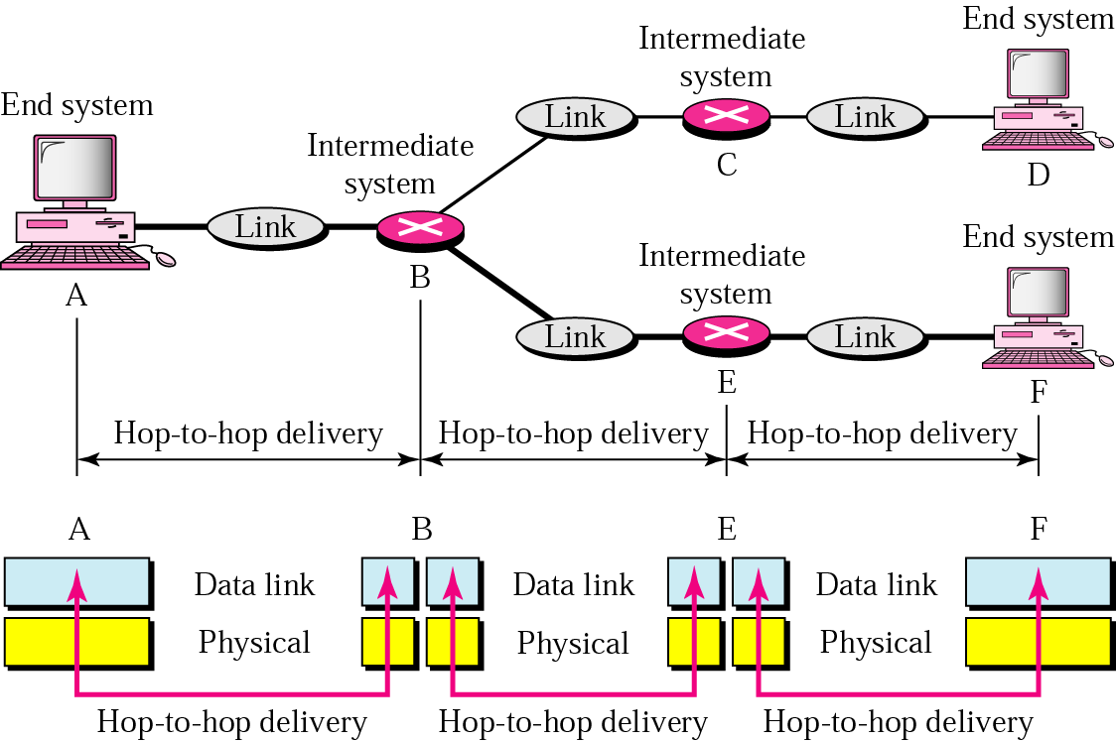
OSI Model (Open Systems Interconnection Model)
Data Link Layer (Hop-to-Hop delivery)

Slide 6
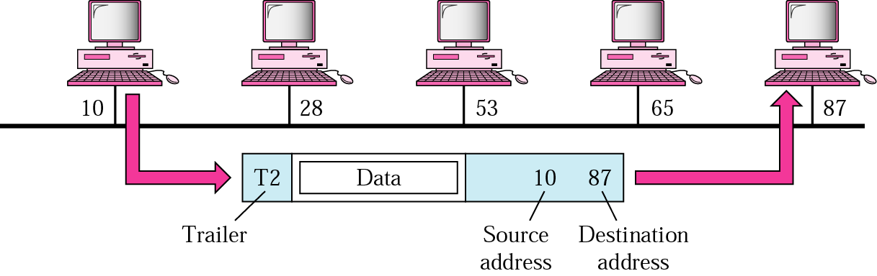
OSI Model (Open Systems Interconnection Model)
Data Link Layer (Example)
In the given Fig. a node with physical address 10 sends a frame to a node with physical address 87. The two nodes are connected by a link. At the data link level this frame contains physical addresses in the header. These are the only addresses needed. The rest of the header contains other information needed at this level. The trailer usually contains extra bits needed for error detection.

Slide 7
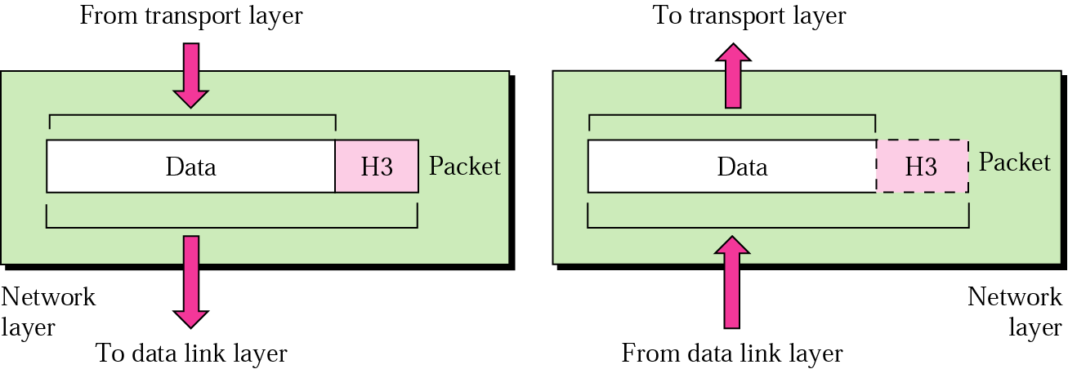
OSI Model (Open Systems Interconnection Model)
Network Layer
Network layer works for the transmission of data from one host to the other located in different networks.
It also takes care of packet routing i.e. selection of the shortest path to transmit the packet, from the number of routes available.
The sender & receiver’s IP address are placed in the header by the network layer.
The network layer is responsible for the delivery of packets from the original source to the final destination.

Slide 8
OSI Model (Open Systems Interconnection Model)
Network Layer
The functions of the Network layer are:
Logical Addressing
Routing
Segment in Network layer is referred as Packet.

Slide 9
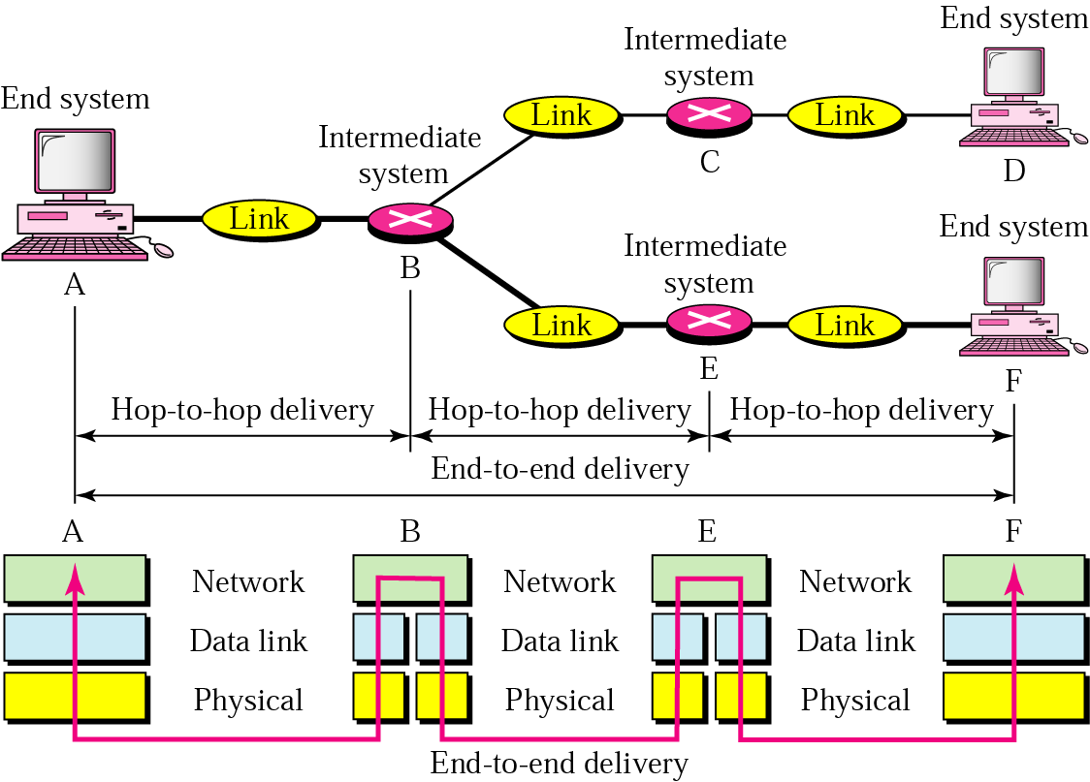
OSI Model (Open Systems Interconnection Model)
Network Layer (Source to destination delivery)

Slide 10
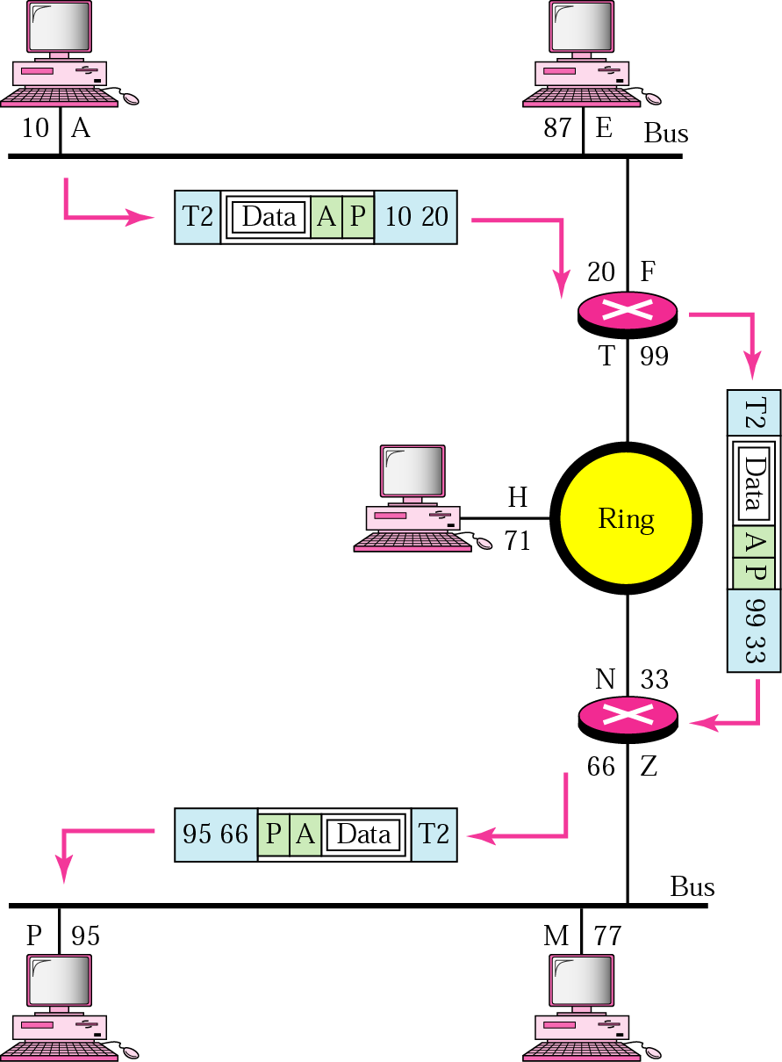
OSI Model (Open Systems Interconnection Model)
Network Layer
In Figure 2.11 we want to send data from a node with network address A and physical address 10, located on one LAN, to a node with a network address P and physical address 95, located on another LAN. Because the two devices are located on different networks, we cannot use physical addresses only; the physical addresses only have local jurisdiction. What we need here are universal addresses that can pass through the LAN boundaries. The network (logical) addresses have this characteristic.

Slide 11
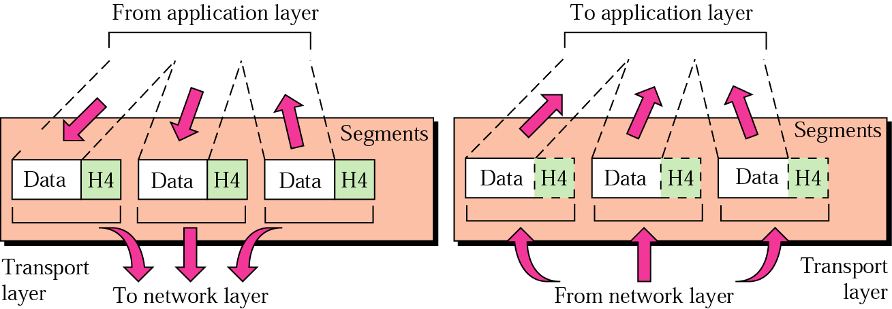
OSI Model (Open Systems Interconnection Model)
Transport Layer
Transport layer provides services to application layer and takes services from network layer.
The data in the transport layer is referred to as Segments.
It is responsible for the End to End Delivery of the complete message.
The transport layer also provides the acknowledgement of the successful data transmission and re-transmits the data if an error is found.
The transport layer is responsible for delivery of a message from one process to another.

Slide 12
OSI Model (Open Systems Interconnection Model)
Transport Layer
The functions of the Transport layer are:
Service-point addressing
Segmentation and Reassembly
Connection control
Flow control
Error control

Slide 13
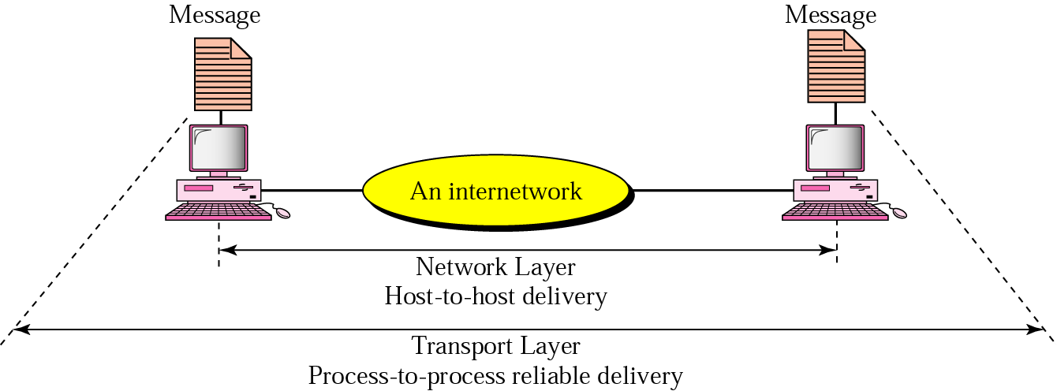
OSI Model (Open Systems Interconnection Model)
Transport Layer (Reliable process-to-process delivery of a message)

Slide 14
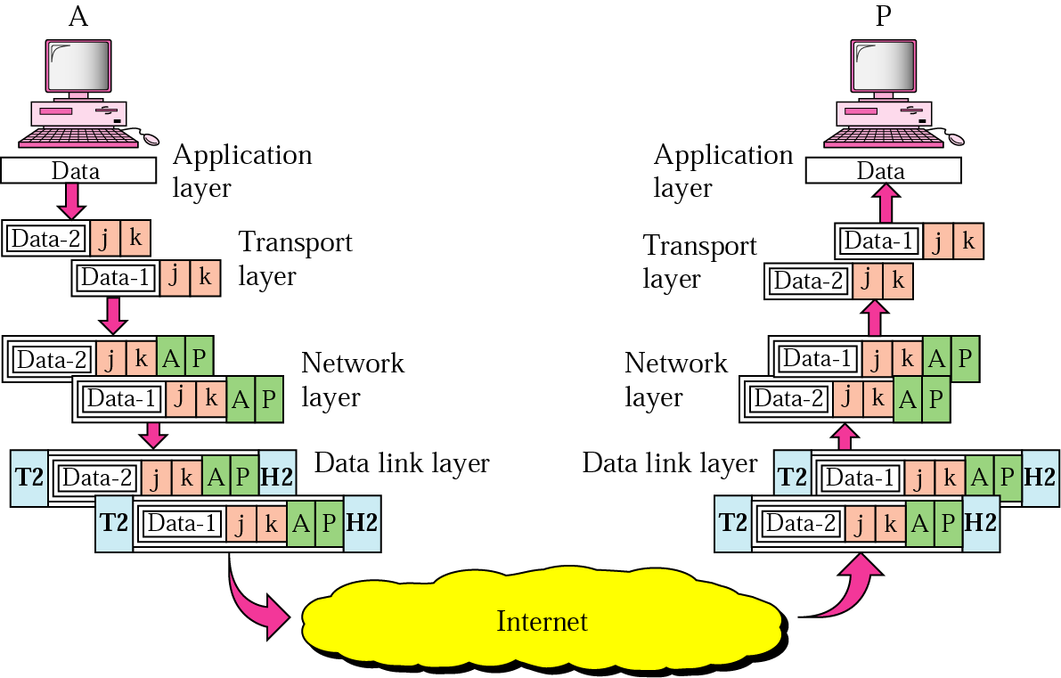
OSI Model (Open Systems Interconnection Model)
Transport Layer
The Figure shows an example of transport layer communication. Data coming from the upper layers have port addresses j and k (j is the address of the sending process, and k is the address of the receiving process). Since the data size is larger than the network layer can handle, the data are split into two packets, each packet retaining the port addresses (j and k). Then in the network layer, network addresses (A and P) are added to each packet.

Slide 15
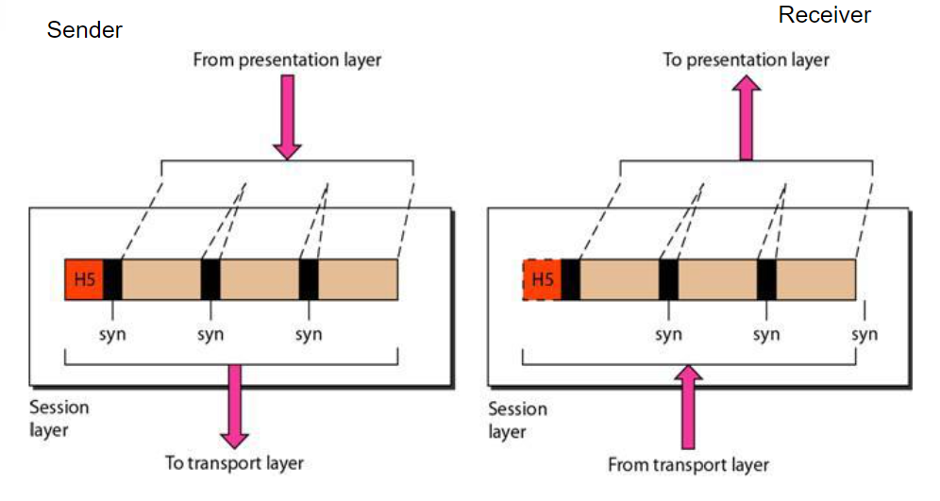
OSI Model (Open Systems Interconnection Model)
Session Layer
The session layer is the fifth layer of the OSI model.
Based on the transport layer, session layer uses the services provided by the transport layer, enables applications to establish and maintain sessions and to synchronize sessions.
This layer is responsible for establishment of connection, maintenance of sessions, authentication and also ensures security.

Slide 16
OSI Model (Open Systems Interconnection Model)
Session Layer
The functions of the session layer are:
Dialog Controller
Synchronization

Slide 17
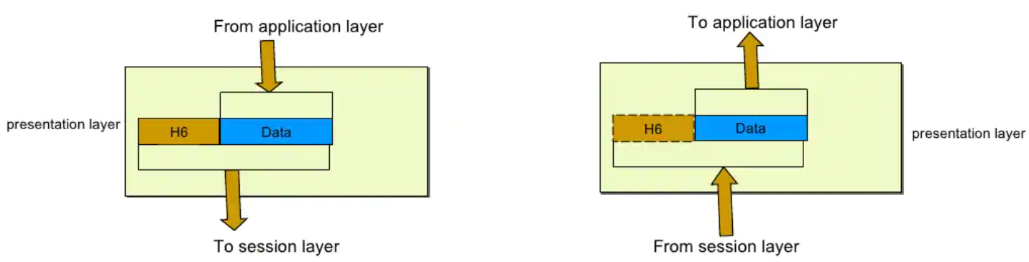
OSI Model (Open Systems Interconnection Model)
Presentation Layer
Presentation layer is also called the Translation layer.
The data from the application layer is extracted here and manipulated as per the required format to transmit over the network.
The main function of this layer is to define the data format and encryption.
The presentation layer is responsible for translation, compression and encryption.

Slide 18
OSI Model (Open Systems Interconnection Model)
Presentation Layer
The functions of the presentation layer are:
Translation
Encryption
Compression

Slide 19
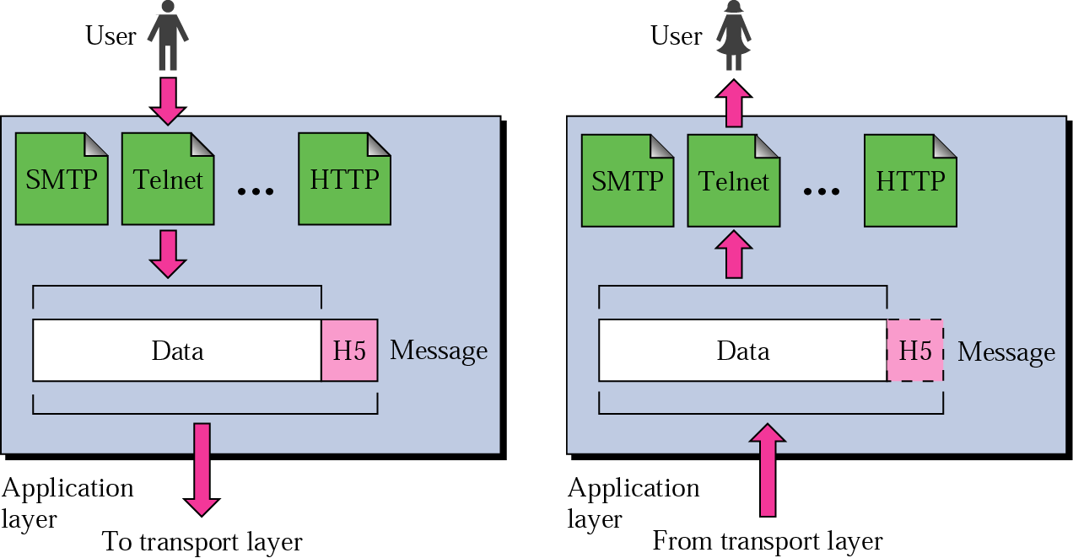
OSI Model (Open Systems Interconnection Model)
Application Layer
At the very top of the OSI Reference Model stack of layers, we find Application layer which is implemented by the network applications.
These applications produce the data, which has to be transferred over the network.
This layer also serves as a window for the application services to access the network and for displaying the received information to the user.
The application layer is responsible for providing services to the user.

Slide 20
OSI Model (Open Systems Interconnection Model)
Application Layer
The functions of the application layer are:
Network virtual terminal
File transfer, access and management
Mail services
Directory services
NOTE
OSI model acts as a reference model and is not implemented in the Internet because of its late invention. Current model being used is the TCP/IP model.

